Slide 1
XYZ Devops Transformation
Presented by Liatrio

Slide 2

Agenda
Introduction
The Challenges
Goal and Objectives
Delivery Structure
Personas
Impact

Slide 3

Introduction
Liatrio is a company dedicated to being a catalyst for change.
We enable our customers to deliver value faster and safer by empowering people, teams, and organizations through modern DevOps practices and Cloud technologies.
We do this by:
Being an ally for our customers
Seeking continuous improvement
Facilitating a culture of feedback
Express strong opinions loosely held
Building a community

Slide 4
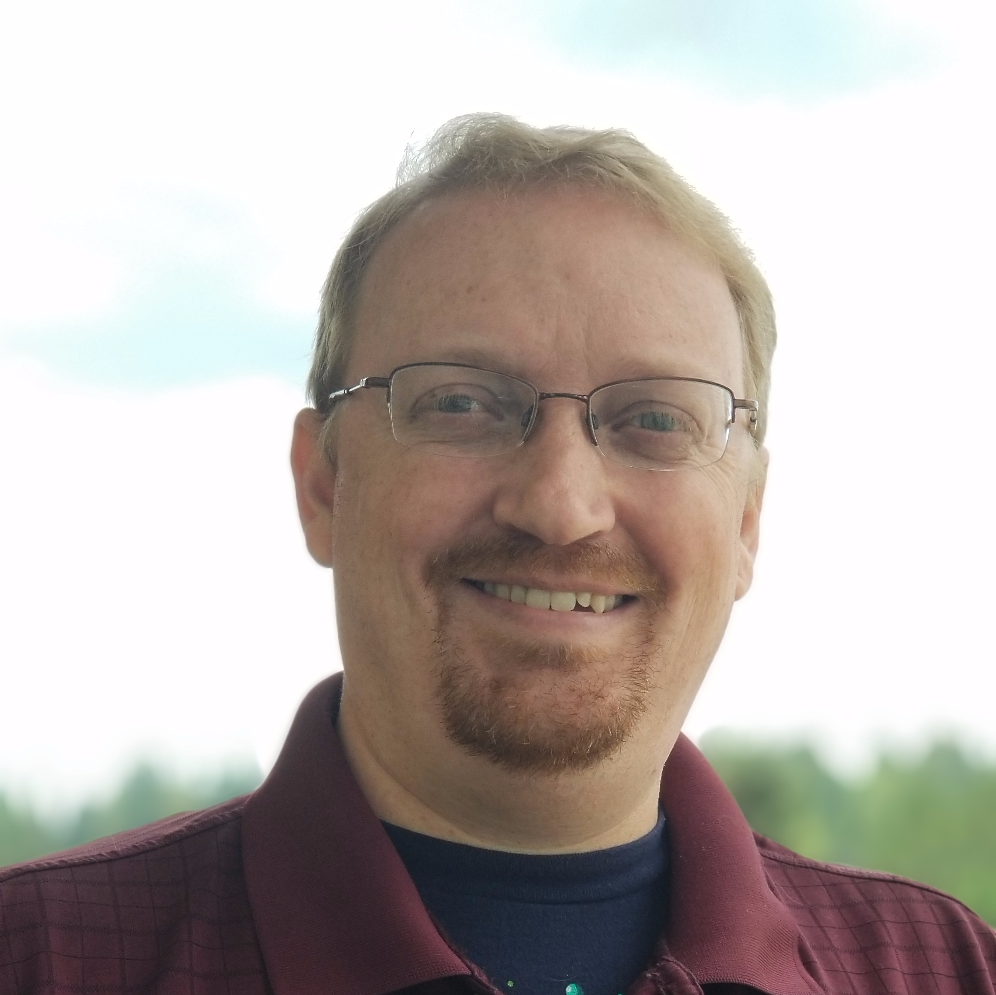
Introduction
Steve Bishop
25 years of experience developing software
11 years of workforce training experience
Program Developer, Workforce Trainer and Dojo Facilitator
Expertise in Agile and DevOps transformations
Former golf professional

Slide 5
The challenges
Why are we here?

Slide 6
The Challenges
Product Environment
Long Lead Times
Lack of Consistency
Developers are having a difficult time provisioning and establishing product environments which is extending the period of time it takes to deliver them.
The value stream to bring a new feature to production and accumulated technical debt is causing longer lead times.
Development and production environments are of varying consistency leading to unique challenges for each product and causing higher expenses.

Slide 7
Goals and Objectives
What are our targets?

Slide 8

“Move XYZ's on-premises product suite to a cloud-based solution while also improving the sustainability of XYZ's products”
- The Primary Goal
Notes:
Let’s start with a singular coalescing idea that clarifies our mission for the delivery of this program.
This goal is the only thing that is inflexible, everything else is subject to change based on feedback and observation.

Slide 9
Objectives and Milestones
Up-skill students on a Continuous Integration and Continuous Delivery mindset
Implement a CI/CD pipeline for automated code validation and shorter lead times to deploy
Improve coding standards using a Linter
Utilize containerization as a tool to make infrastructure more modular
Start deploying code to the cloud to simplify provisioning new environments
Up-skill students on TDD and ATDD to provide a more sustainable code base
Implement DORA metrics to measure the change in performance of the development process
Establish a DevOps culture to improve collaboration between teams
Notes:
These objective and milestones have been identified as lower-level achievements we can make that help us achieve the ultimate goal.

Slide 10
Delivery Structure
How will this be achieved?

Slide 11
Schedule
Observation Phase
Liatrio experts will be on location to observe and interact with pre-selected students who will attend the pilot cohort.
Development Phase
A dedicated team of Liatrio experts will curate and compile learning materials. This will involve the careful selection of pre-existing content and the creation of new content where necessary.
Delivery Phase
Liatrio DevOps subject matter experts will facilitate lectures, exercises, and Dojo sessions for hands-on training.
Reflective Phase
Final look at the program success and areas of opportunity with the Liatrio experts and XYZ stakeholders.
Notes:
Observation phase
Experts on location to observe and interact with students
Familiarize the team with the students
Understand their various working domains
Gather detailed information about the challenges
Enable the experts to prioritize the skills and tools
An opportunity for early identification of potential issues
Development Phase
Experts curate learning materials
Tailor the martials to the needs discovered during observation phase
Maximum 2 month window
Delivery Phase
Two half day sessions
First half introduces new concepts through short lectures and practical exercises
Second half is a dojo environment
Students apply knowledge to their own code bases
Instructors engage students during the dojo and provide guidance
Correct mistakes in real-time
Students will practice pair and mob programming while performing exercises and dojo work
Weekly retrospectives to evaluate the effectiveness of the new skills and practices
Reflective Phase
Based on the Kirkpatrick model of evaluating effectiveness of training
Begin to ask questions such as
How did the students react to the training?
How much did the students learn?
How much did the students change their behavior?
How much did the training impact the business?
30/60/90 day surveys

Slide 12
Daily Workshops
Each day will begin with a short lecture (max 30 minutes) followed by a 3-4 hour exercise to practice that day's lesson.
Students will be divided into groups to generate a culture of shared responsibility and communication
Workshops will have a goal for the groups to achieve and provided the resources necessary to achieve it
Instructors will regularly observe and engage with the students to provide guidance

Slide 13
Daily Dojos
Focus is on production work
Instructors continue to monitor, sit with, and work with students as they go about their work
Students perform work in groups so as to reinforce the mentality of shared responsibility and communication
Instructors will take note of any important subjects that need to be added to the training

Slide 14
Personas
Who would benefit from this training?

Slide 15
Personas
Junior Engineers
Engineers who may have some exposure to DevOps but lack experience
Mid/Senior Engineers
Engineers who have access to tools but not know the full scope of their capabilities
Staff Engineers
Engineers looking to improve the quality of code deployments
System Architects
Architects looking for new technologies to help them solve some of the domain challenges they face

Slide 16
Impact
What impact will this have on the business?

Slide 17
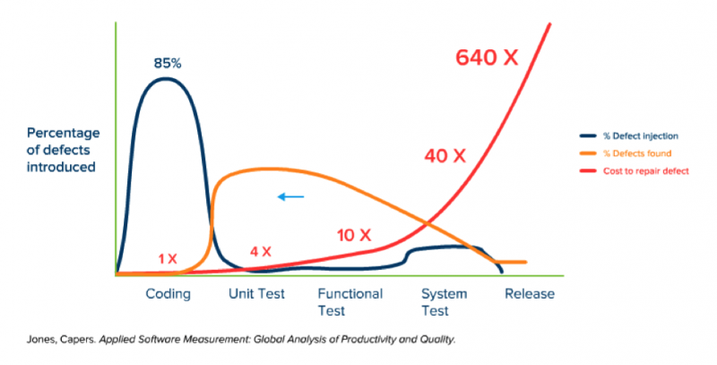
Traditional Deployments

Slide 18
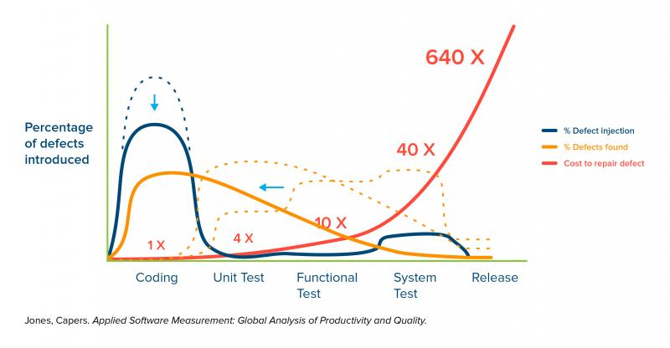
DevOps Deployment
Shift-Left Software Testing

Slide 19
Table
 | Category 1 | Category 2 | Category 3 | Category 4
Item 1 | 4.5 | 2.3 | 1.7 | 5
Item 2 | 3.2 | 5.1 | 4.4 | 3
Item 3 | 2.1 | 1.7 | 2.5 | 2.8
Item 4 | 4.5 | 2.2 | 1.7 | 7

Slide 20
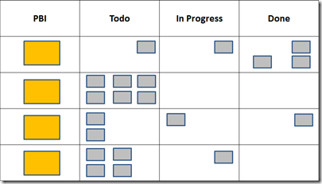




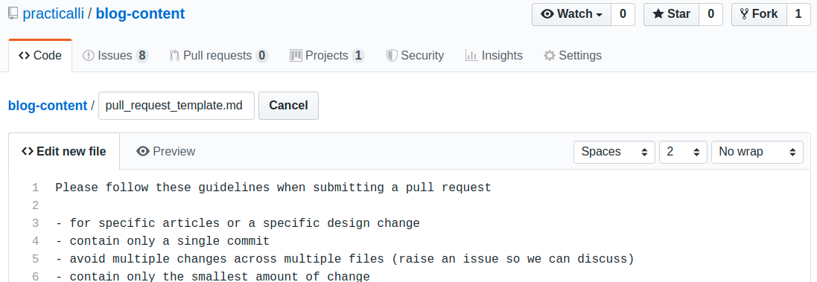


Slide 21
The way to get started is to quit talking and begin doing.
Walt Disney

Slide 22
Title 2 column
Subtitle
Subtitle
Add text, images, art, and videos.
Add transitions, animations, and motion.
Save to OneDrive to get to your presentations from your computer, tablet, or phone.
Open the Design Ideas pane for instant slide makeovers.
When we have design ideas, we’ll show them to you right there.

Slide 23
Title 3 column
Subtitle
Subtitle
Subtitle
Add text, images, art, and videos.
Add transitions, animations, and motion.
Save to OneDrive to get to your presentations from your computer, tablet, or phone.
Open the Design Ideas pane for instant slide makeovers.
When we have design ideas, we’ll show them to you right there.
This PowerPoint theme uses its own unique set of colors, fonts, and effects to create the overall look and feel of these slides.
PowerPoint has tons of themes to give your presentation just the right personality.

Slide 24



Summary
With PowerPoint, you can create presentations and share your work with others, wherever they are. Type the text you want here to get started. You can also add images, art, and videos on this template. Save to OneDrive and access your presentations from your computer, tablet, or phone.

Slide 25




Thank you
Presenter name
Email address
Website

